Slide 1
Image to Text to Speech conversion with intonation using machine learning for regional language.
Under the guidance of Prof. Dr. Madhushankara. M
Submitted by:
Pooja C A – 201046012,
Karthik Ballullaya MK – 201046029,
K. Viswateja - 201046042

Slide 2

Introduction

Slide 3
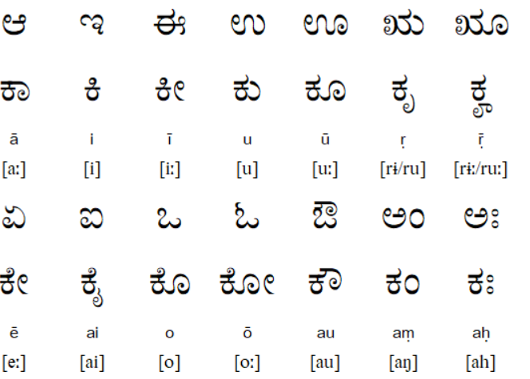
Kannada Language
Kannada ಕನ್ನಡ less commonly known as Kanarese) is a Dravidian language spoken predominantly by the people of Karnataka in south western region of India.

Slide 4
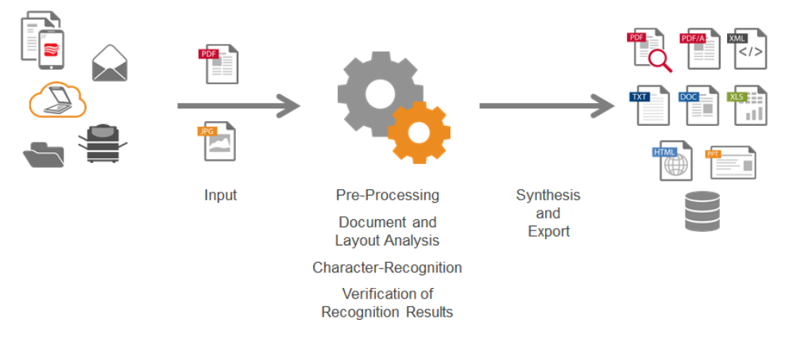
Optical character recognition (OCR)
Optical character recognition or optical character reader is the electronic or mechanical conversion of images of typed, handwritten or printed text into machine-encoded text, whether from a scanned document, a photo of a document, a scene-photo or from subtitle text superimposed on an image.

Slide 5
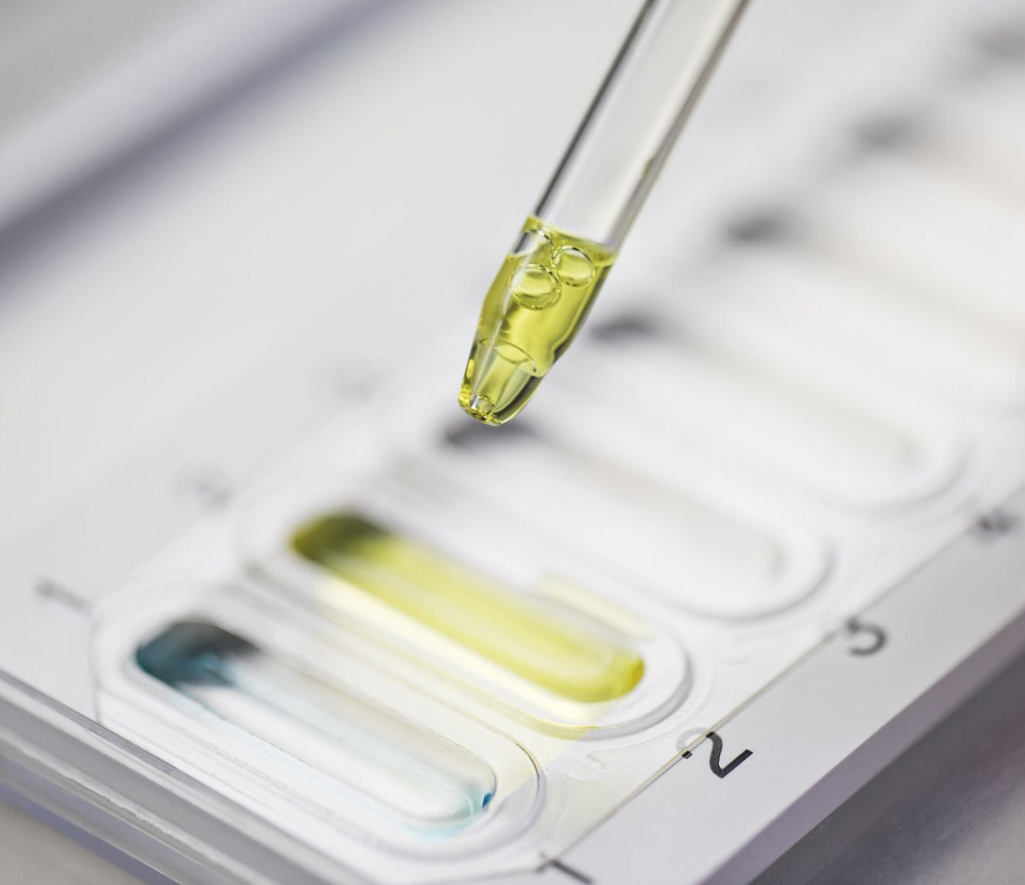
Char74K Dataset
Sample data

Slide 6
Char74K Dataset
Dataset has both handwritten and signs captured in them
657 classes.
Images include vowels, Consonants, conjunct consonants and Numerals.
Each class consist max 10 handwritten images.
Each image is of the dimension : 1200 x 900 pixels.
They are written with white background in black colour.

Slide 7
Preprocessing: Feature augmentation
Technique used in increase the amount of data.
They can change the geometry, colour, scale, skew, rotation etc

Slide 8
Work progress

Slide 9
Data preprocessing
Data augmentation:
Denoising the image
Adding Gaussian noise to image
Adding salt noise
Changing the contrast
Thinning the image contour
Rotation of image by +-15deg
Cropping the image
Adding Padding
Using these techniques, we have increased the dataset to 250 images per class

Slide 10
Methods
SVM
K-NN
CNN
Transfer Learning
Tensorflow
Keras
Conv2D Layer
Flatten Layer

Slide 11
References
http://www.ee.surrey.ac.uk/CVSSP/demos/chars74k/

Slide 12
Thank you

